Slide 1

Gradient Descent
by
KIET Group of Institutions

Slide 2
Gradient Descent
Gradient descent is an optimization algorithm used to find the values of parameters (coefficients) of a function (f) that minimizes a cost function (cost).

Slide 3
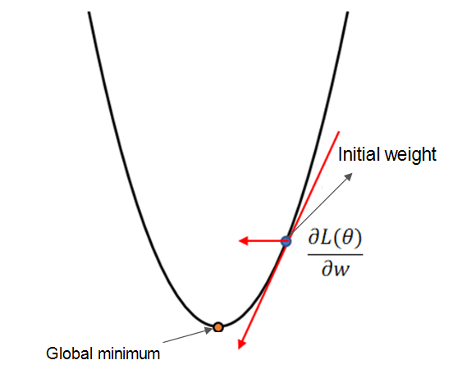
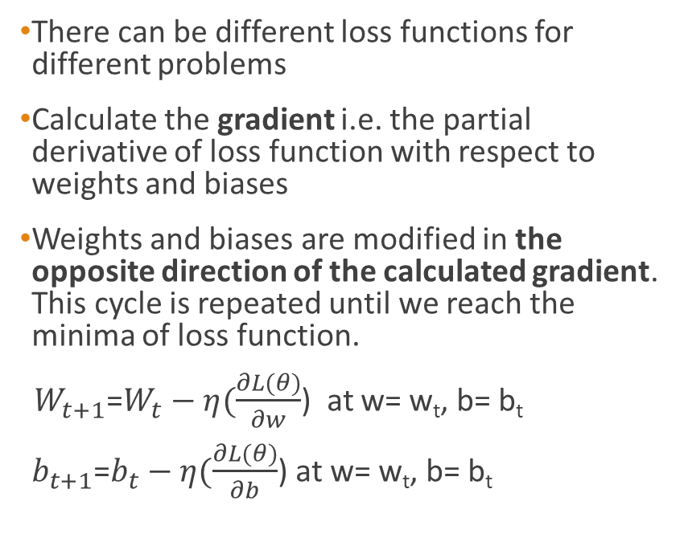
Gradient Descent
There can be different loss functions for different problems
Calculate the gradient i.e. the partial derivative of loss function with respect to weights and biases
Weights and biases are modified in the opposite direction of the calculated gradient. This cycle is repeated until we reach the minima of loss function.
${ W}_{t+1}$=$W_{t}−η(\frac{∂L(θ)}{∂w}$) at w= w_{t}, b= b_{t}
$b_{t+1}$=$b_{t}−η(\frac{∂L(θ)}{∂b}$) at w= w_{t}, b= b_{t}

Slide 4
Gradient Descent Procedure
The procedure starts off with initial values for the coefficient or coefficients for the function. These could be 0.0 or a small random value.
coefficient = 0.0
The cost of the coefficients is evaluated by plugging them into the function and calculating the cost.
cost = f(coefficient)
or
cost = evaluate(f(coefficient))

Slide 5
Gradient Descent Procedure
The derivative of the cost is calculated. The derivative is a concept from calculus and refers to the slope of the function at a given point. We need to know the slope so that we know the direction (sign) to move the coefficient values in order to get a lower cost on the next iteration.
delta = derivative(cost)
Now that we know from the derivative which direction is downhill, we can now update the coefficient values. A learning rate parameter (alpha) must be specified that controls how much the coefficients can change on each update.
coefficient = coefficient – (alpha * delta)
This process is repeated until the cost of the coefficients (cost) is 0.0 or close enough to zero to be good enough.

Slide 6
Types of Gradient Descent
Depending on the number of training examples considered in updating the model parameters, we have 3-types of gradient descents:
Batch Gradient Descent: Parameters are updated after computing the gradient of error with respect to the entire training set
Stochastic Gradient Descent: Parameters are updated after computing the gradient of error with respect to a single training example
Mini-Batch Gradient Descent: Parameters are updated after computing the gradient of error with respect to a subset of the training set

Slide 7
Batch Gradient Descent
In Batch Gradient Descent, all the training data is taken into consideration to take a single step.
We take the average of the gradients of all the training examples and then use that mean gradient to update our parameters. So that’s just one step of gradient descent in one epoch.
Batch Gradient Descent is great for convex or relatively smooth error manifolds. In this case, we move somewhat directly towards an optimum solution.

Slide 8

Batch Gradient Descent
Here the full batch is fed to the model together, predictions are done on the full data set and error is calculated as:
So, it takes the error of all the samples in the batch and calculates the sum of all the errors. Now, due to the fact it takes in the full set together, in one epoch it updates the weights only once.

Slide 9
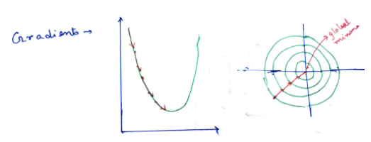
Batch Gradient Descent
If we visualize the descent,it will look something like this.
So, we can see that gradient descent is pretty smooth and loss function converges quickly. Here in the case of Batch Descent, we have to send the whole batch, if it has 1 million entries, it will be computationally very inefficient. So, we need to move to something different

Slide 10
Stochastic Gradient Descent
Gradient descent can be slow to run on very large datasets.
Because one iteration of the gradient descent algorithm requires a prediction for each instance in the training dataset, it can take a long time when you have many millions of instances.
In situations when you have large amounts of data, you can use a variation of gradient descent called stochastic gradient descent.
While in GD, you have to run through ALL the samples in your training set to do a single update for a parameter in a particular iteration, in SGD, on the other hand, you use ONLY ONE training sample from your training set to do the update for a parameter in a particular iteration. If you use SUBSET, it is called Minibatch Stochastic gradient Descent.

Slide 11
Steps for Stochastic Gradient Descent
Take an example
Feed it to Neural Network
Calculate it’s gradient
Use the gradient we calculated in step 3 to update the weights
Repeat steps 1–4 for all the examples in training dataset

Slide 12
Stochastic Gradient Descent
Here one sample of the training set is passed through the model at a time. So, the error is calculated as
Error =(y actual — y pred)²
It is very fast. It updates the weights after each error calculation.
If there are 100 samples in the set, in an epoch, SGD updates the weights 100 times once after each sample is predicted by the model.
Now, each time, it tries a new sample which in most cases will be different from the previous one, correspondingly the distribution of the weights will also vary accordingly. Say there may be an outlier, for which the feature value distribution is different, correspondingly the weight distribution will vary for the sample, and it will be different from the previous sample. So, the gradient descent will get a bit noisy.

Slide 13
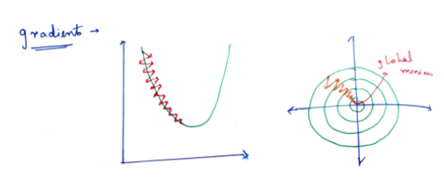
Stochastic Gradient Descent
Its visualization will look like,
So, we can see, here also it converges, but the descent gets a bit noisy. This noise makes the gradient descent slow for Stochastic Gradient Descent.

Slide 14
Minibatch Gradient Descent
Neither we use all the dataset all at once nor we use the single example at a time. We use a batch of a fixed number of training examples which is less than the actual dataset and call it a mini-batch. Doing this helps us achieve the advantages of both the Stochastic and batch gradient descent.
So, after creating the mini-batches of fixed size, we do the following steps in one epoch:
Pick a mini-batch
Feed it to Neural Network
Calculate the mean gradient of the mini-batch
Use the mean gradient we calculated in step 3 to update the weights
Repeat steps 1–4 for the mini-batches we created

Slide 15

Minibatch Gradient Descent
Here we divide the whole training data set into smaller mini-batches and train using those. So, if there are 100 data in the training set and we take 25 as our sampling size, we obtain 4 mini-batches. The error is calculated as:
where k is the number of samples in a batch. So, in each epoch, the error is calculated for 4 batches and updated 4 times. Here also, there is a noise problem but it is less compared to SGD.

Slide 16
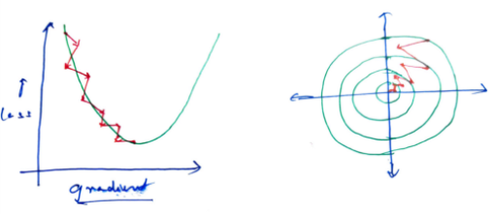
Minibatch Gradient Descent
If we visualize this we will get,
we will get something like this. We can see, there is noise but it is much less than the SGD. But to speed up the gradient descent we need to remove the noise as much as possible and dampen the vertical component of the movement as much as possible.

Slide 17
Difference between Batch Gradient Descent and Stochastic Gradient Descent
S.NO. | Batch Gradient Descent | Stochastic Gradient Descent
1. | Computes gradient using the whole Training sample | Computes gradient using a single Training sample
2. | Slow and computationally expensive algorithm | Faster and less computationally expensive than Batch GD
3. | Not suggested for huge training samples. | Can be used for large training samples.
4. | Deterministic in nature. | Stochastic in nature.
5. | Gives optimal solution given sufficient time to converge. | Gives good solution but not optimal.
6. | No random shuffling of points are required. | The data sample should be in a random order, and this is why we want to shuffle the training set for every epoch.
7. | Can’t escape shallow local minima easily. | SGD can escape shallow local minima more easily.
8. | Convergence is slow. | Reaches the convergence much faster.

Slide 18
Thank You

